Slide 1

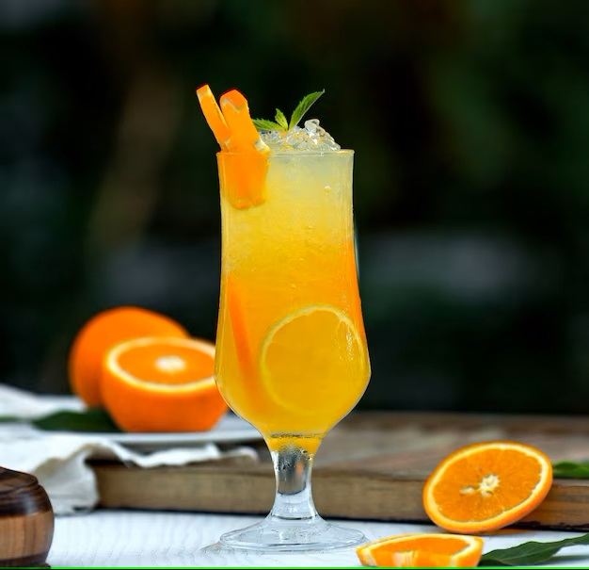
Product incidence & brand health report – Tropicana
Presented by
Anish Sengupta
Madhushree
Orijita Adhikary
Sanjukta Dey

Slide 2
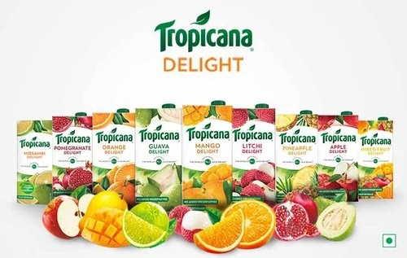
Agenda
Introduction & Objectives
Research Design
Incidence of Packaged fruit juice & Findings
Usage and Purchase Habits
Brand Health Report
Brand Image Analysis
Conclusion

Slide 3
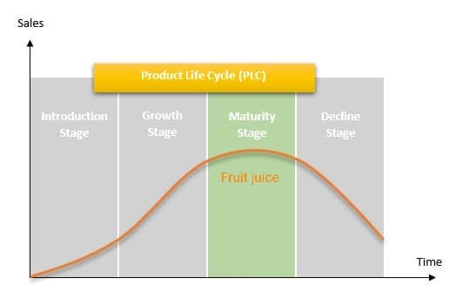
Introduction
The estimated revenue in fruit juice market amounts to Rs 7123 cr in 2023. The market is expected to grow annually by 2.92% (CAGR 2023-2027). In PLC the juice category is in Maturity stage.
Objectives
To study the incidence of Packaged fruit juice as a product category
To understand it's usage & buying behavior
Analyze the Brand Health and Brand Image of Tropicana packaged fruit juice

Slide 4
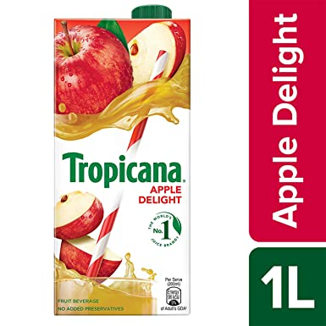
Research Design
Research Type:
  Quantitative Research
  Descriptive Research
  Cross - Sectional Research
Target Group:
  Age: 15-45 years
  Usage: Bought packaged fruit juice in the last one month
Sample Size: 406
Sampling Techniques:
  Random Sampling

Slide 5
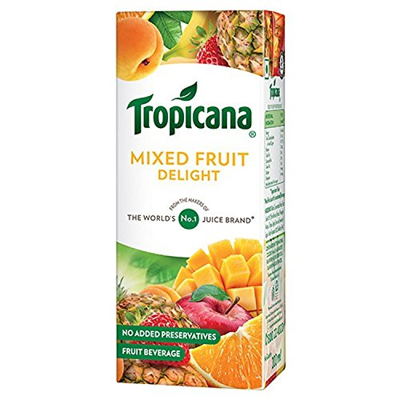
Incidence of Packaged fruit juice
Purchased Packaged fruit juice in the last month
203
Incidence
64%
Target sample size
318
Total Sample Size
406

Slide 6

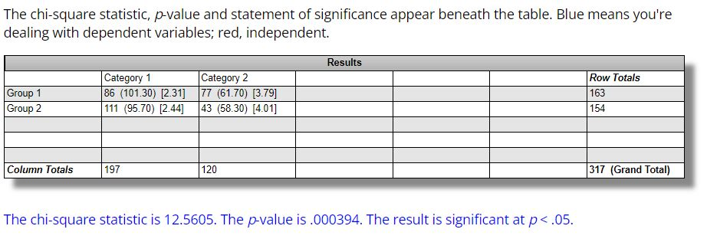
Findings
Gender wise Incidence
Gender wise Incidence
Male | 64.0%
Female | 64.2%

Slide 7
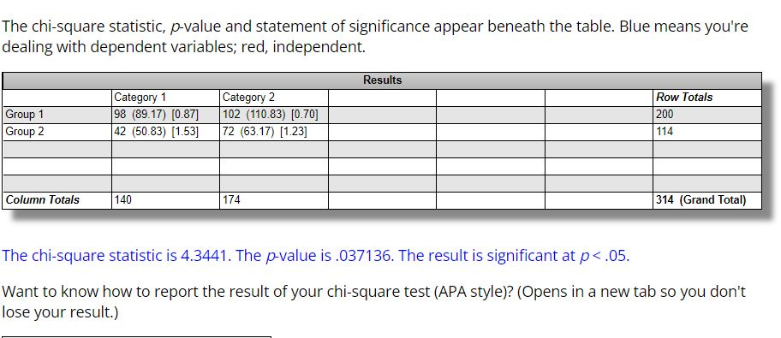
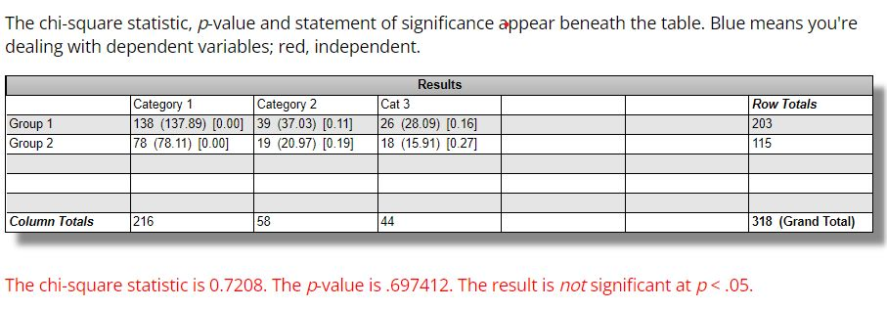
Occupation-wise Incidence
Location-wise Incidence

Slide 8
Purchase Behaviour (Past one month)

Slide 9
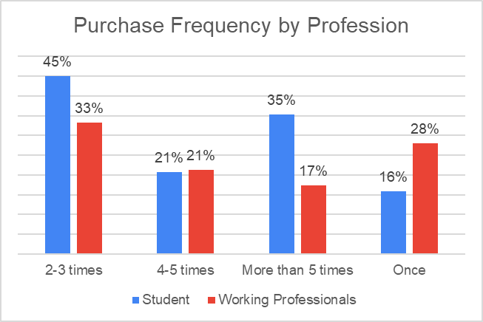
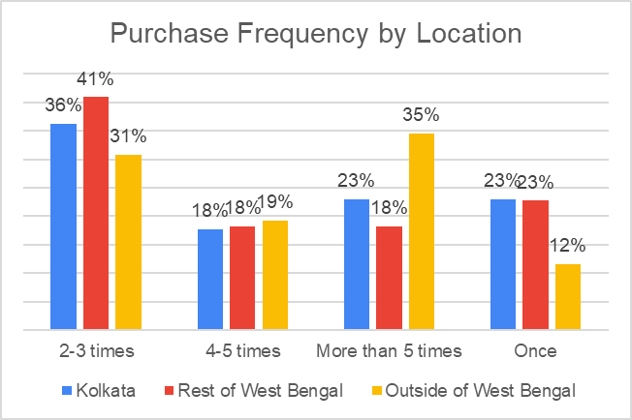

Slide 10
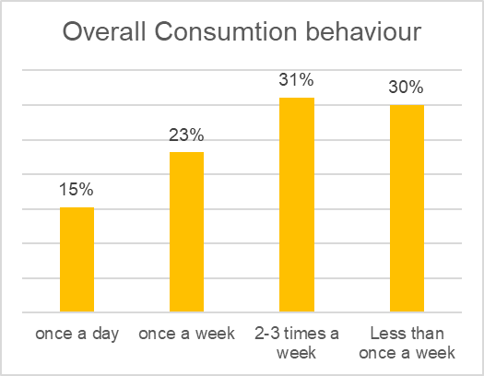
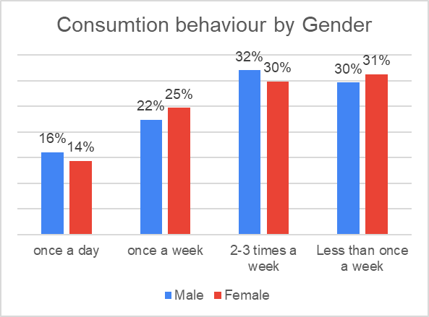
Consumption Behaviour

Slide 11
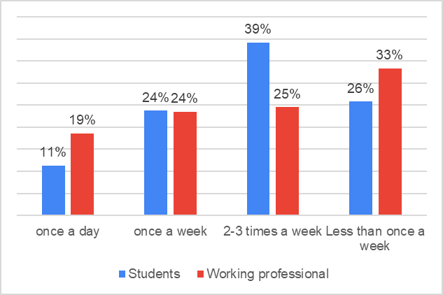
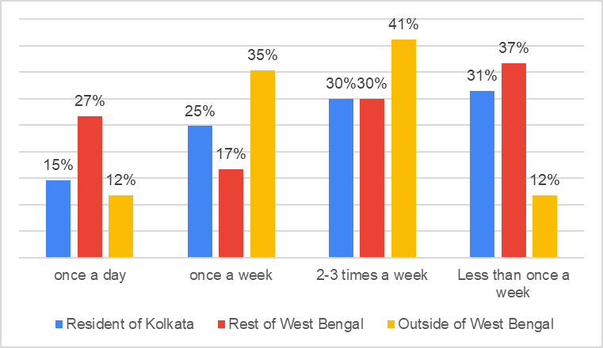
Consumption behaviour by Profession
Consumption behaviour by Location

Slide 12
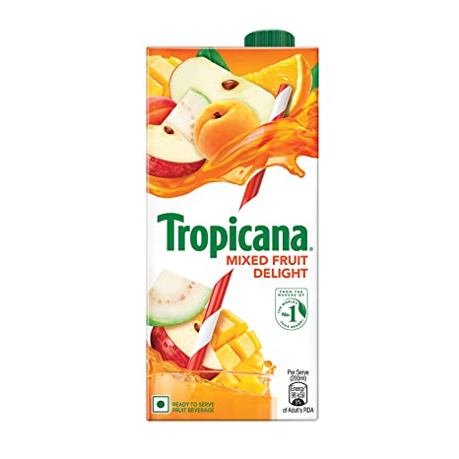
Brand Health Report
TOM Vs. Total Awareness
Brand Funnel

Slide 13
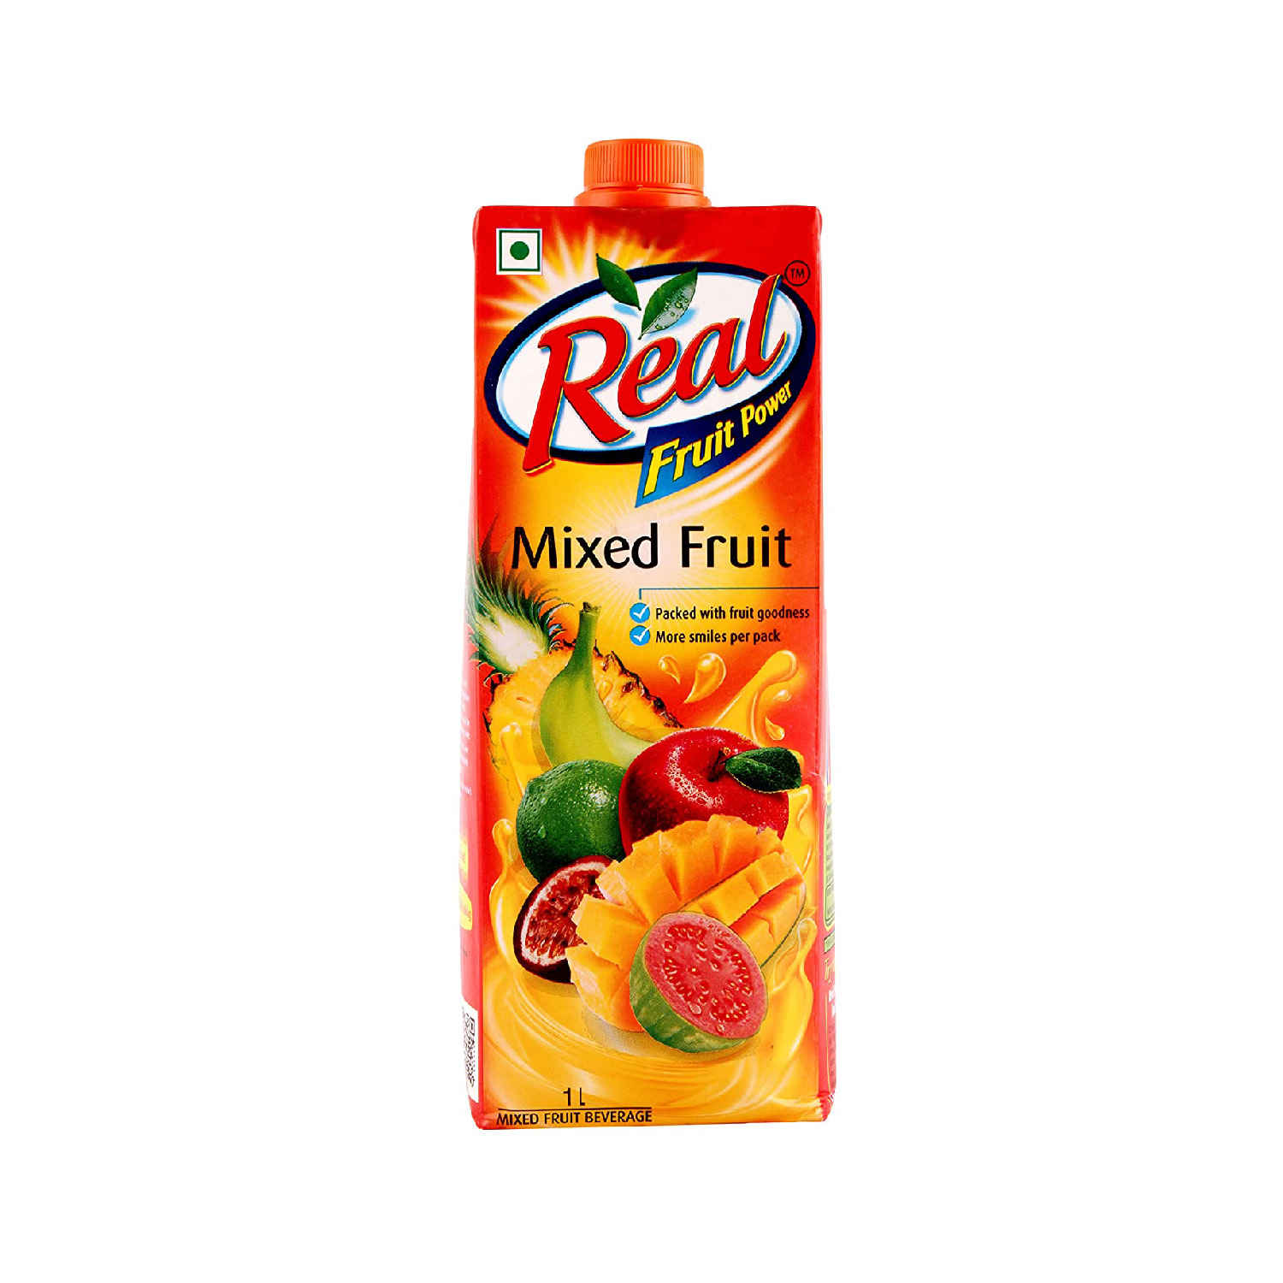
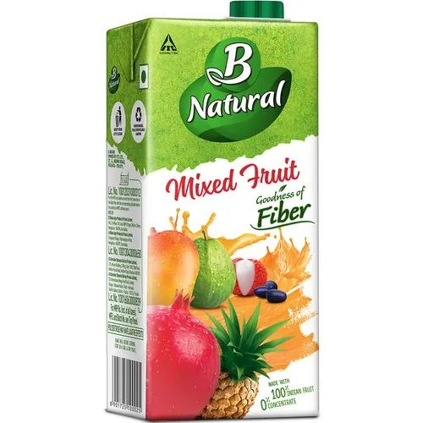

TOM Vs. Total Awareness
 | TOM | Total Awareness
Real | 44% | 84%
Tropicana | 18% | 83%
B - Natural | 3% | 41%

Slide 14
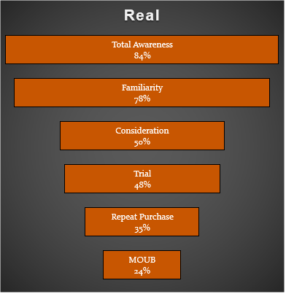
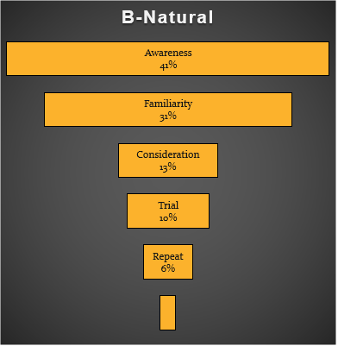
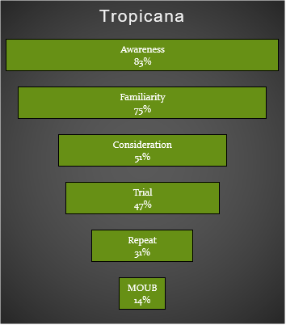
Brand Funnel
MOUB
2%

Slide 15
Purchase Habits of MOUB

Slide 16
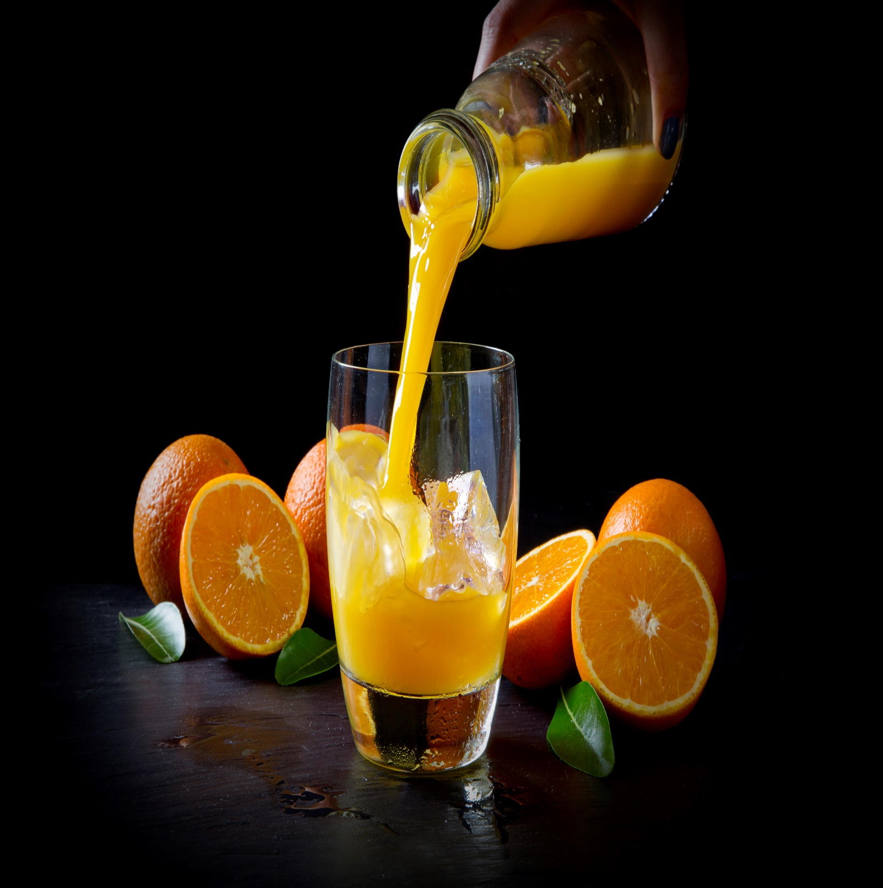
Brand Loyalty

Slide 17
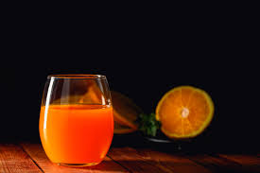
Product Perception

Slide 18
Brand Image Analysis

Slide 19
Analysis of Driving Factors on Tropicana's Performance
 | Coefficients | P-value
Intercept | -0.45355 | 0.207214
Taste | 0.663628 | 0.001064
Natural | 0.117646 | 0.622797
Nutritious | 0.171348 | 0.449449
Quality | 0.268444 | 0.263744
Availability of flavors | 0.444969 | 0.030436
R Square | 0.39655
Adjusted R Square | 0.388892
F Value | 51.78249
Significance F | 3.24E-41

Slide 20
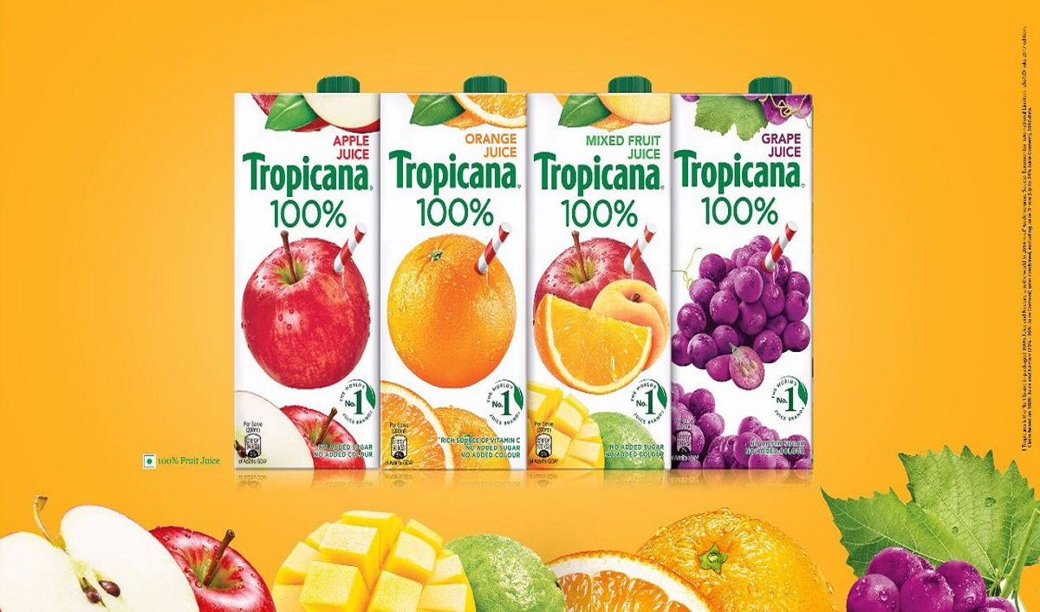
Summary
The incidence is high among students than in the working professional.
The MOUB - Repeat ratio is second highest among the competitors.
Most of the loyal customers buy Tropicana from Kirana and E-commerce.
Taste and availability of flavors are the driver factors for the product perception of Tropicana.
Taste wise Tropicana is good but there is a scope to improve it’s nutritious value.
Although Tropicana has an attractive packaging but they have to improve their brand trust level.

Slide 21
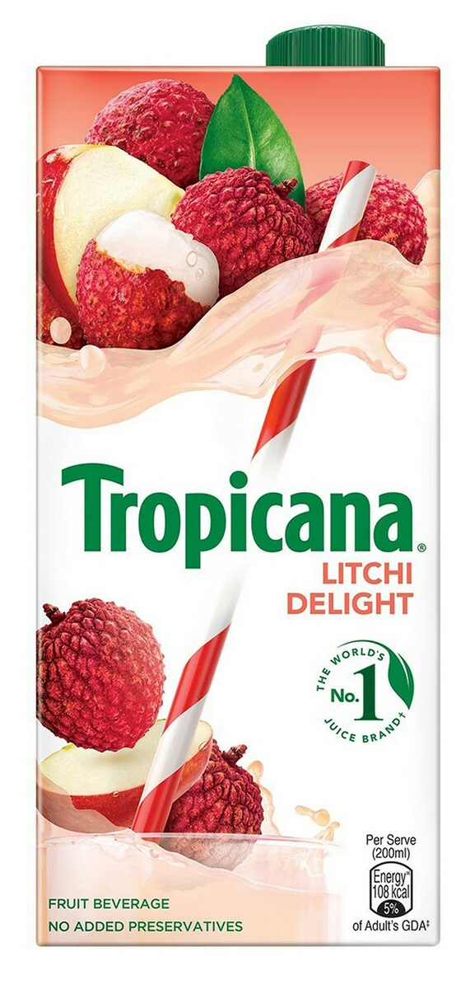
Thank You

